Slide 1




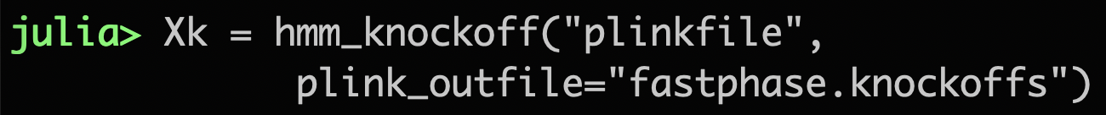
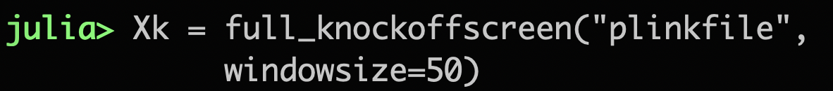
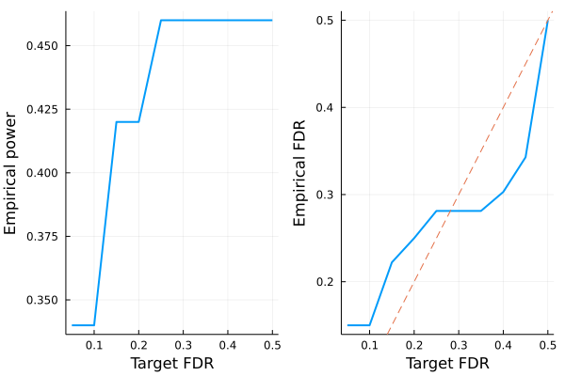
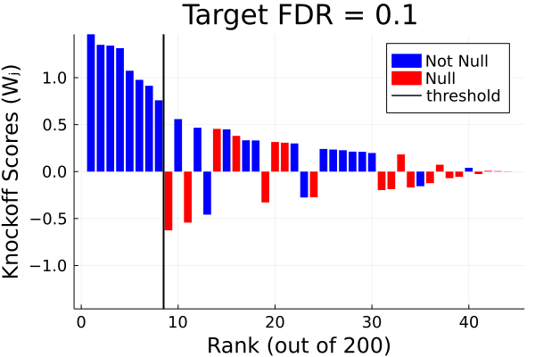
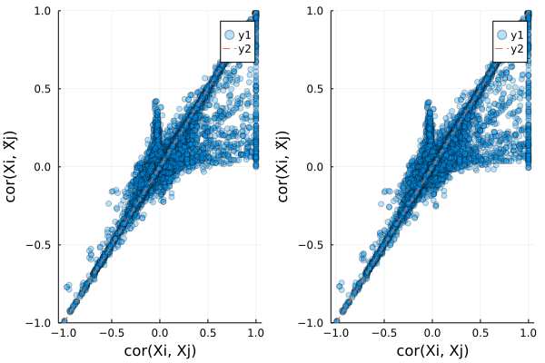
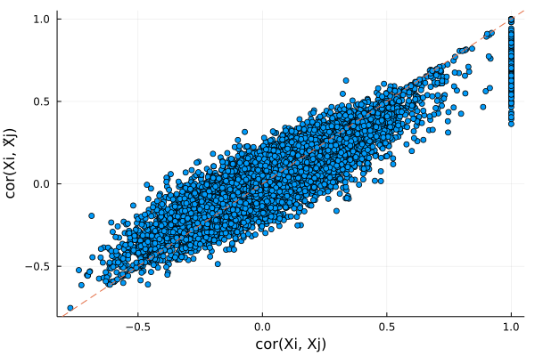
Knockoffs.jl: Variable Selection with Knockoffs in
Benjamin B. Chu, Chiara Sabatti
Department of Biomedical Data Sciences, Stanford University
Contact: bbchu@stanford.edu, sabatti@stanford.edu
Software page: https://github.com/biona001/Knockoffs.jl
Documentation: https://biona001.github.io/Knockoffs.jl/dev
Package Feature & Comparisons
Introduction
Currently, Knockoffs.jl supports Gaussian covariates (fixed-X or model-X) and covariates that can be modeled by a hidden Markov model (HMM) commonly used in genetic studies.
Do you need to perform variable selection?
Does your features/covariates exhibit arbitrary correlation structure?
And you still want to control the False Discovery Rate (FDR)?
Knockoffs.jl is a Julia package for generating statistical knockoffs that will control the FDR when performing variable selection, even when variables are arbitrarily correlated.
As the name suggests, the knockoff filter operates by manufacturing knockoff variables that are cheap — their construction does not require collecting any new data — and are designed to mimic the correlation structure found within the original variables. The knockoffs serve as negative controls and they allow one to identify the truly important predictors, while controlling the false discovery rate (FDR) — the expected fraction of false discoveries among all discoveries.
 | Language | Fixed-X knockoffs | Model-X knockoffs | HMM knockoffs | Sequential knockoffs | Supported data formats
Knockoffs.jl | Julia | SDP and equi | SDP and equi | Single-SNP fastPHASE and SHAPEIT | Single only | Numeric matrix, binary PLINK
Knockoff-filter | Matlab and R | SDP, equi, ASDP | SDP, equi, ASDP |  |  | Numeric Matrix
SNPKNOCK and SNPKNOCK2 | R/C++ |  |  | SHAPEIT and fastPHASE (single and group SNPs) |  | Binary PLINK and BGEN
KnockoffScreen | R |  |  |  | Single and multiple | VCF, BGEN
knockpy | Python | MVR, MAXENT, SDP, equi, CI | MVR, MAXENT, SDP, equi, CI |  |  | Numeric Matrix
Development Roadmap for Knockoffs.jl: Support for BGEN/VCF/PGEN inputs, MVR fixed/model-X knockoffs, more efficient sequential knockoffs, grouped HMM knockoffs, linear-time model-X knockoffs
Examples of using Knockoffs.jl
Two Goals of Knockoffs
Generate fixed-X knockoffs with equicorrelated construction
Generate exact model-X SDP knockoffs (i.e. known mean and variance)
Generate 2nd order model-X SDP knockoffs (mean and covariance estimated)
Generate hidden Markov model (HMM) knockoffs by running fastPHASE on unphased genotype data stored in binary PLINK format
Generate multiple knockoffs as in KnockoffScreen by sliding window
1. Instead of controlling FWER*, the knockoff procedure controls the FDR
This significantly improves power.
2. Knockoff based inference tests conditional hypotheses.
If is a variable or a group of variables, we test
where means all variables except . Conditioning on removes variables only marginally associated with the response due to high correlation. In genetics, this helps us prioritize causal associations.
*FWER: Family-wise error rate – this is what Bonferroni correction controls
Example Results Visualized
Compare Power vs FDR for simulation studies
Display knockoff statistics for simulation studies
The Knockoff-Filter Procedure
For each sample , generate knockoffs s.t.
. E.g. If , then
Compute feature importance statistic on matrix
For all , compute knockoff scores
Choose all such that , where depends on FDR
Comparing HMM knockoffs on 1000 samples from UK Biobank Chr10 data
Comparing for all j in HMM knockoffs
Knockoffs.jl
SNPKNOCK

